Slide 1
Spotify Music Trends
Shrey Jaradi (A20518260)
Chris Chen (A20502563)
Abdul Raqeeb Muhammad Yousaf (A20471861)
Sohaib Jawad (A20516885)

Slide 2
Research Questions
Predict danceability of a song belong to based on specific features
Predict the year of the song based on different characteristics like album cover etc.
Given a song, what are some other recommendations that would suit the same user’s taste?
Can we predict the popularity of a song based on given features?
Which genre got famous/changed according to year and why?
Which feature affects the popularity of a song the most?
Who are the popular artists?
Predicting if a new artist is going to be popular based on its audio features

Slide 3
Data Source
All the data sets were from Kaggle
 | Link | Question Answered
Data Set 1 | https://www.kaggle.com/datasets/lehaknarnauli/spotify-datasets?resource=download&select=tracks.csv | – Who are the popular artists – Predicting if a new artist is going to be popular based on its audio features. – Which feature affects the popularity of a song the most?
Data Set 2 | https://www.kaggle.com/datasets/mrmorj/dataset-of-songs-in-spotify?resource=download | – Predict danceability of a song belong to based on specific features
Data Set 3 | https://www.kaggle.com/code/akiboy96/spotify-song-popularity-genre-exploration/data?select=genre_music.csv | - Popular Genre according to year

Slide 4
Data Processing
Ensure that we do not have any duplicate rows.
Removing outliers.
For any missing value, we will not consider that feature for that row in the analysis(depends if 80% of data is missing)
Check for skewness in data

Slide 5
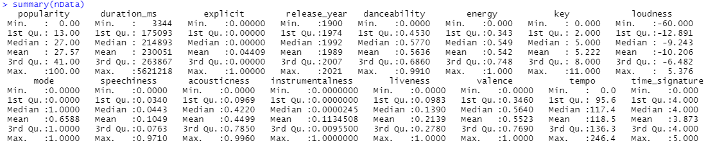
Data Processing

Slide 6
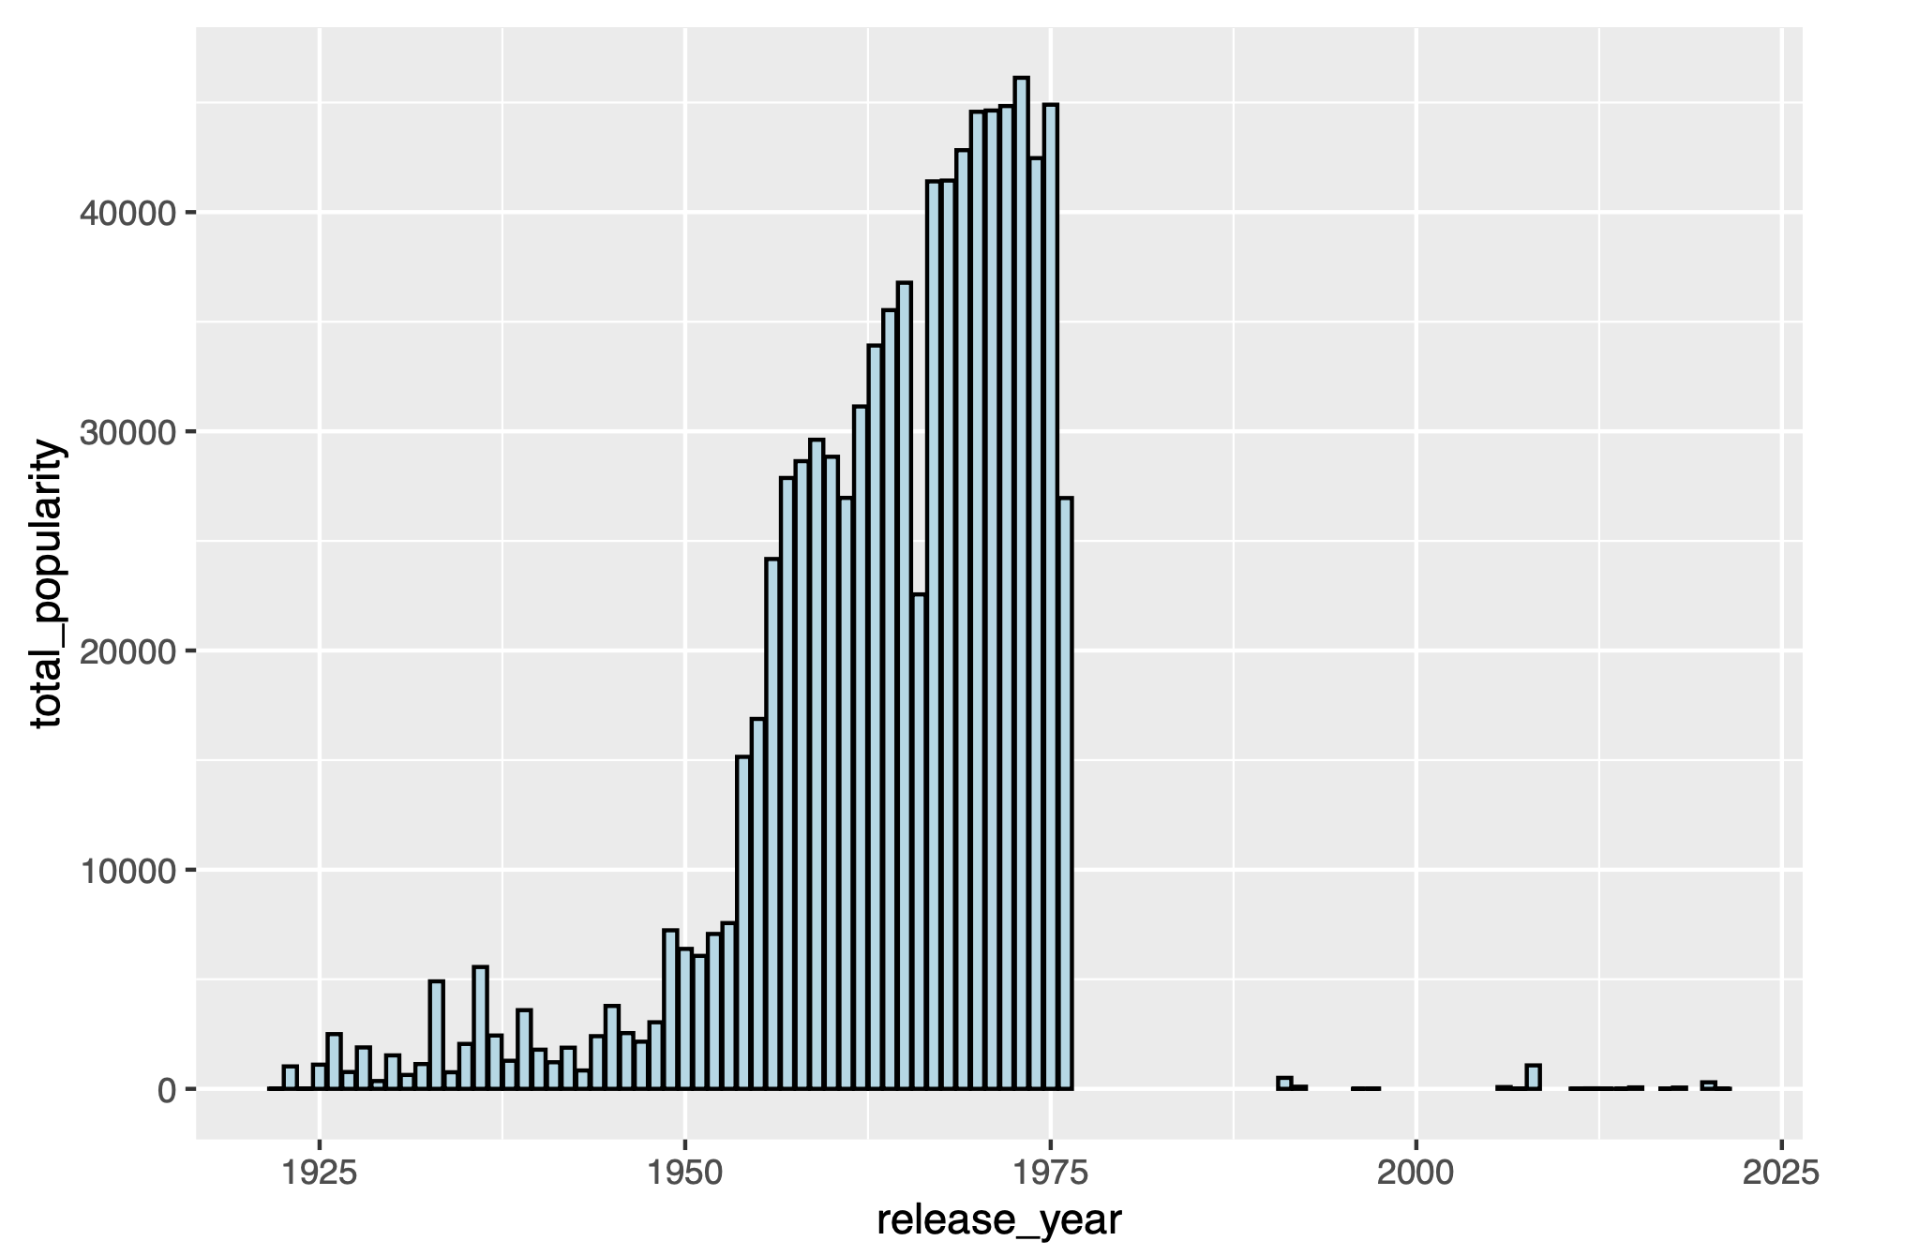
Analysis - Music got popular
This plot shows us how people started listening songs, as in 1920s it’s not much popular, then people started listening music tremendously, and it got increased.
Those decrease after 1975 , we saw in the data, that we were not having much data, that’s why so much drop.

Slide 7
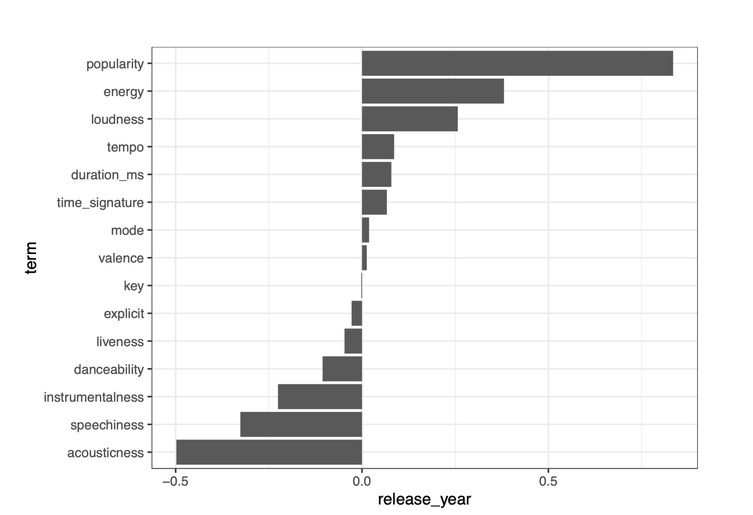
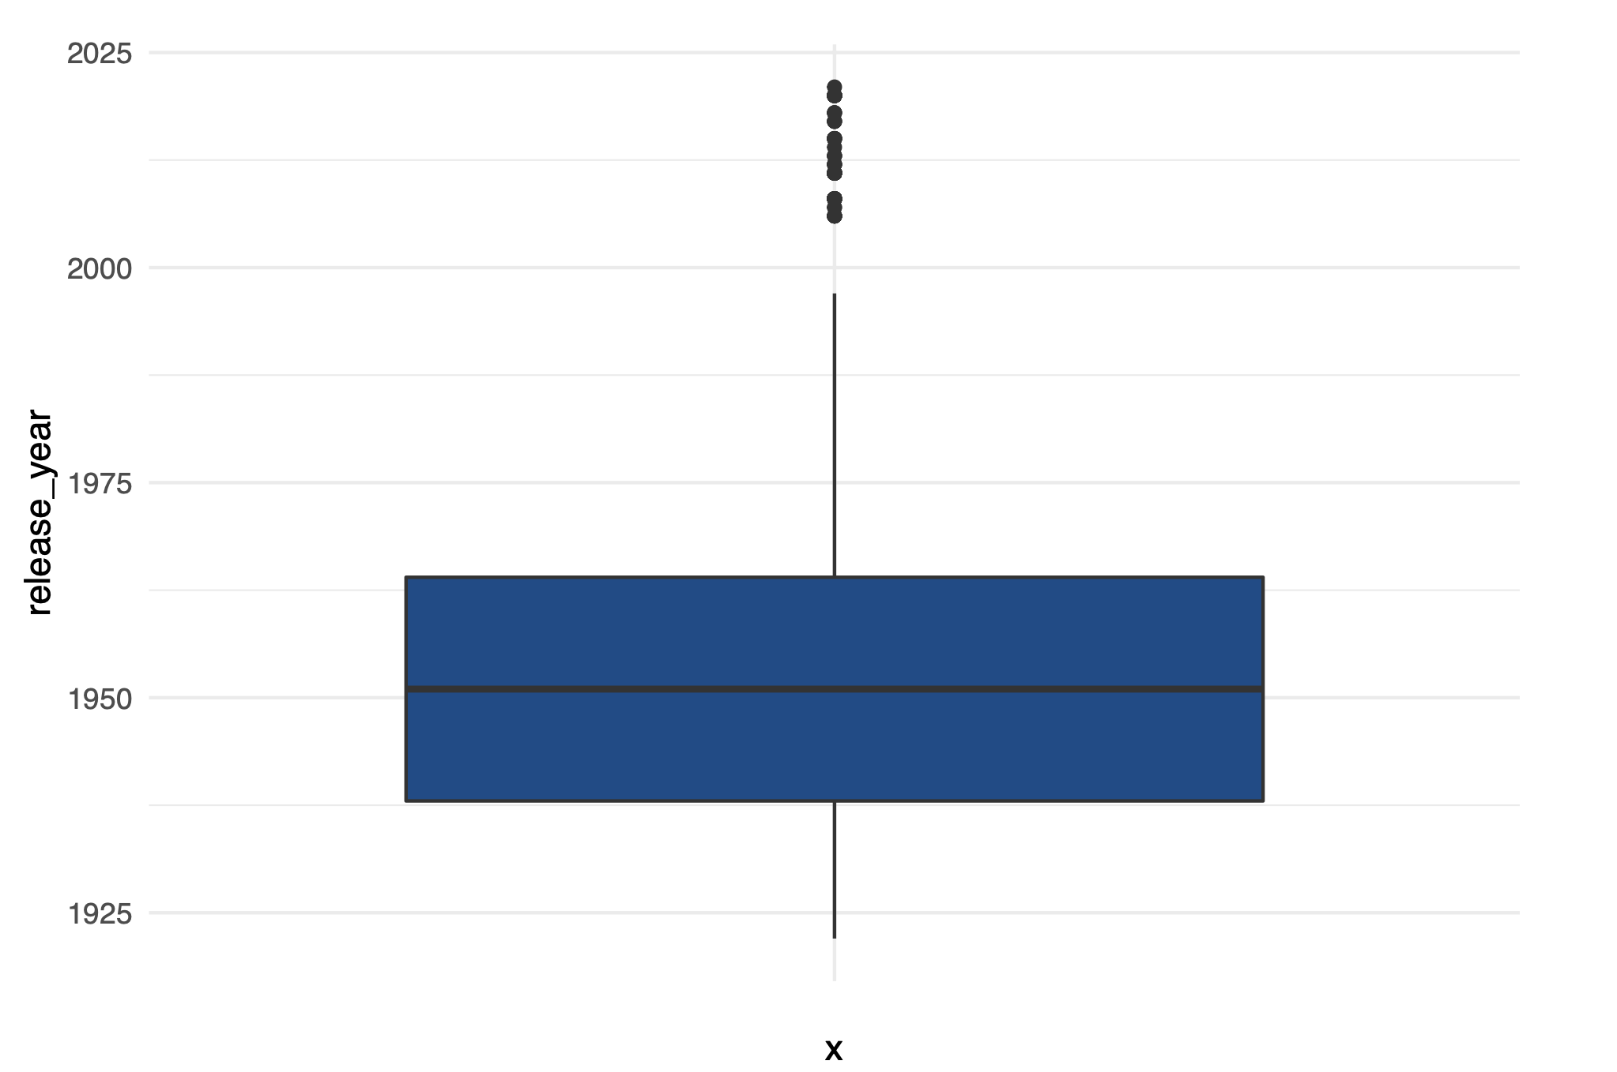
Analysis - Outliers and Correlation
To predict the year, we first found out about the outliers in our year feature and removed it, and found out the correlation between the release_year feature and other features.

Slide 8
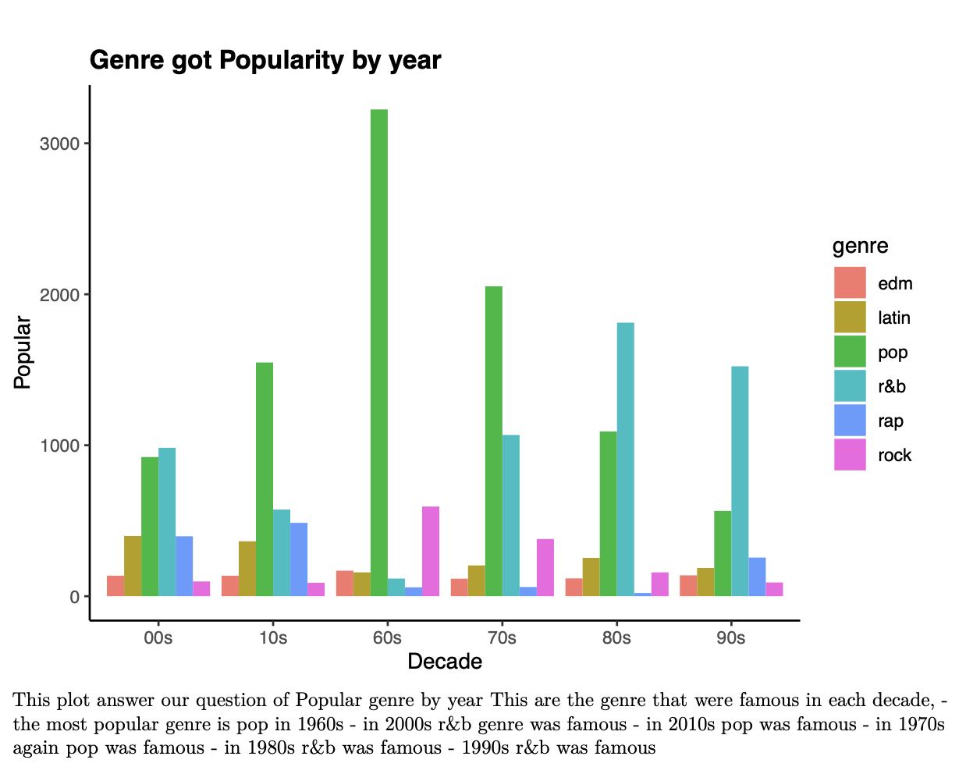
Analysis - Popular Genre in Decade
Pop is famous genre among most of the year, even we can say that pop was in it’s peak in 60s, and after r&b comes into the picture that got popular after 70s.

Slide 9
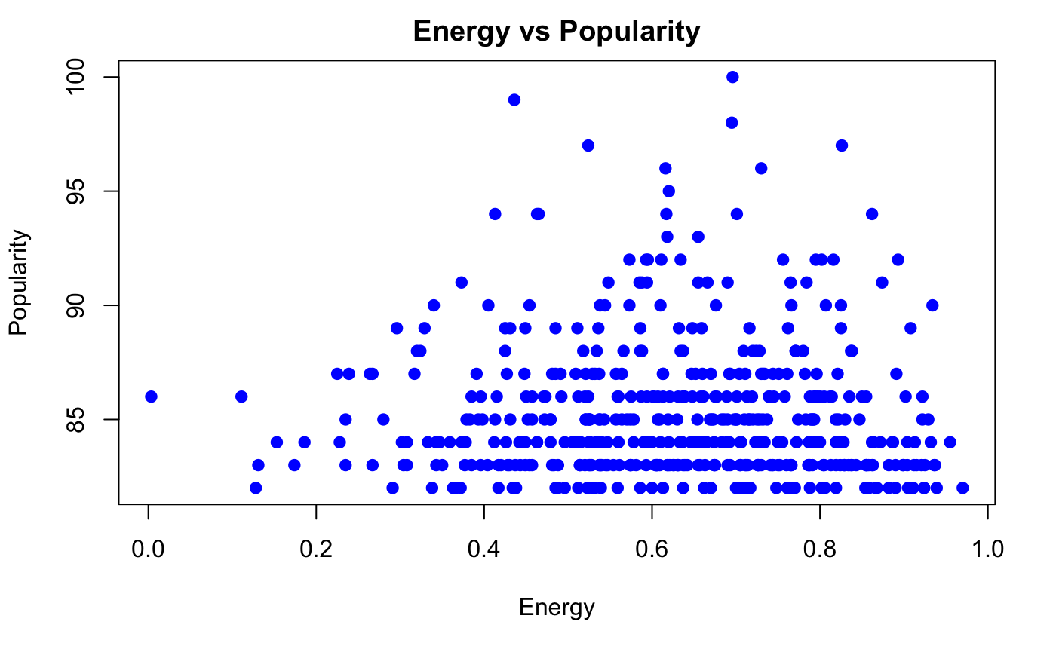
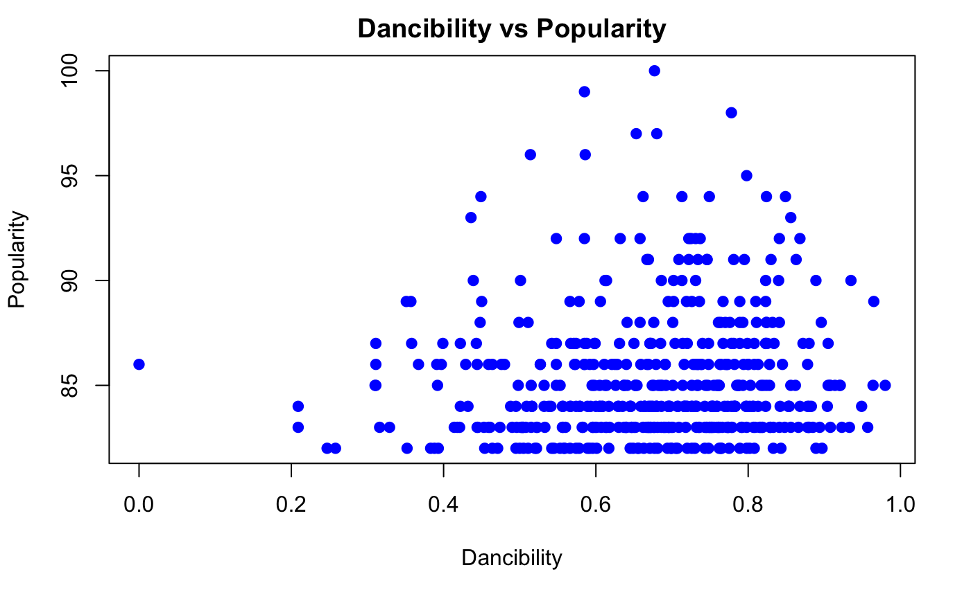
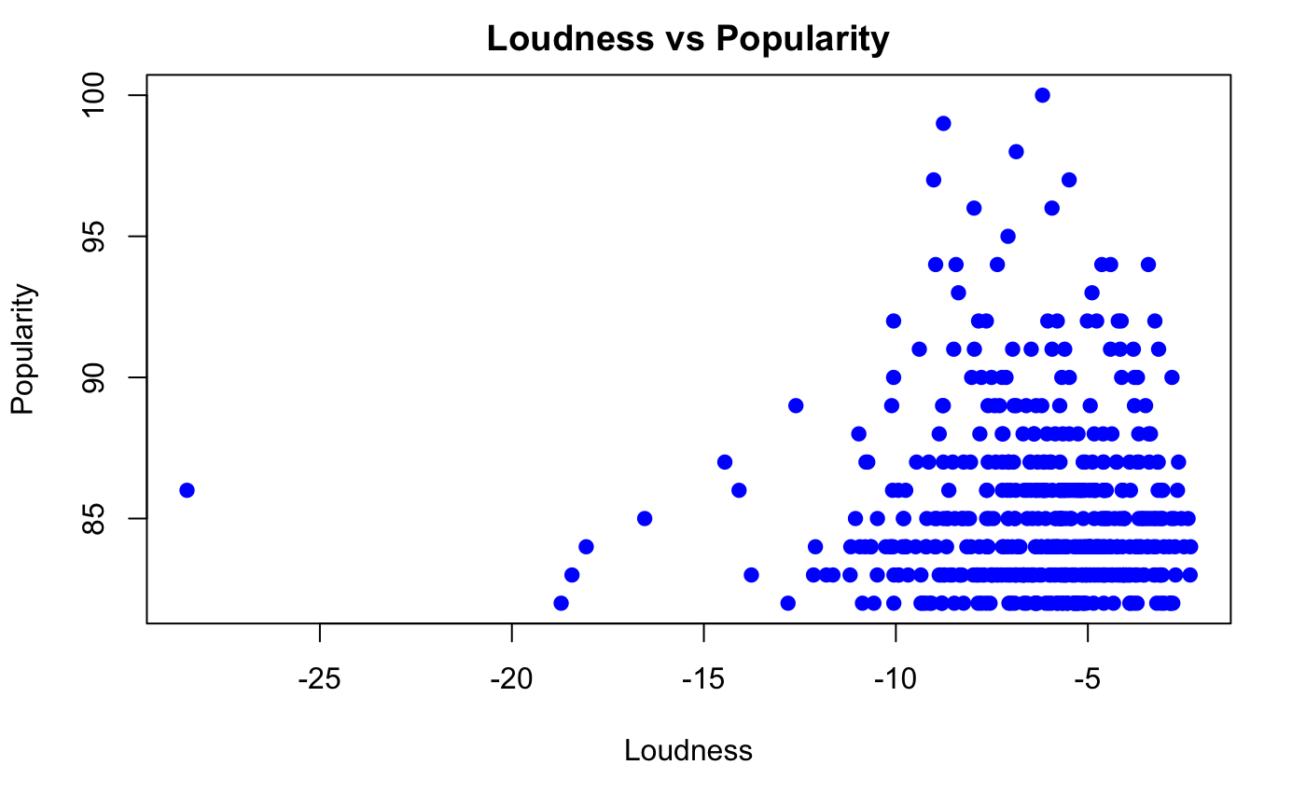
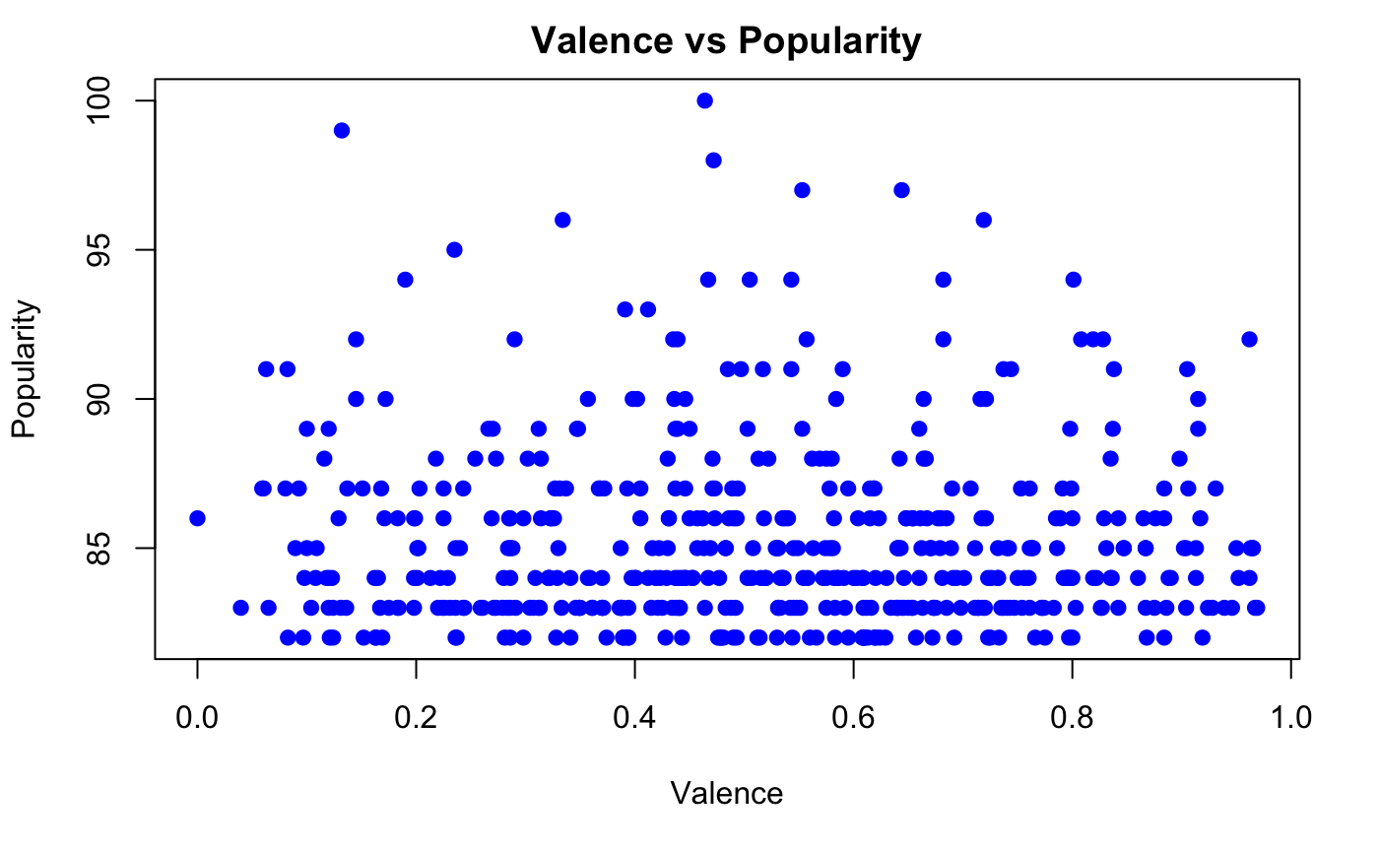
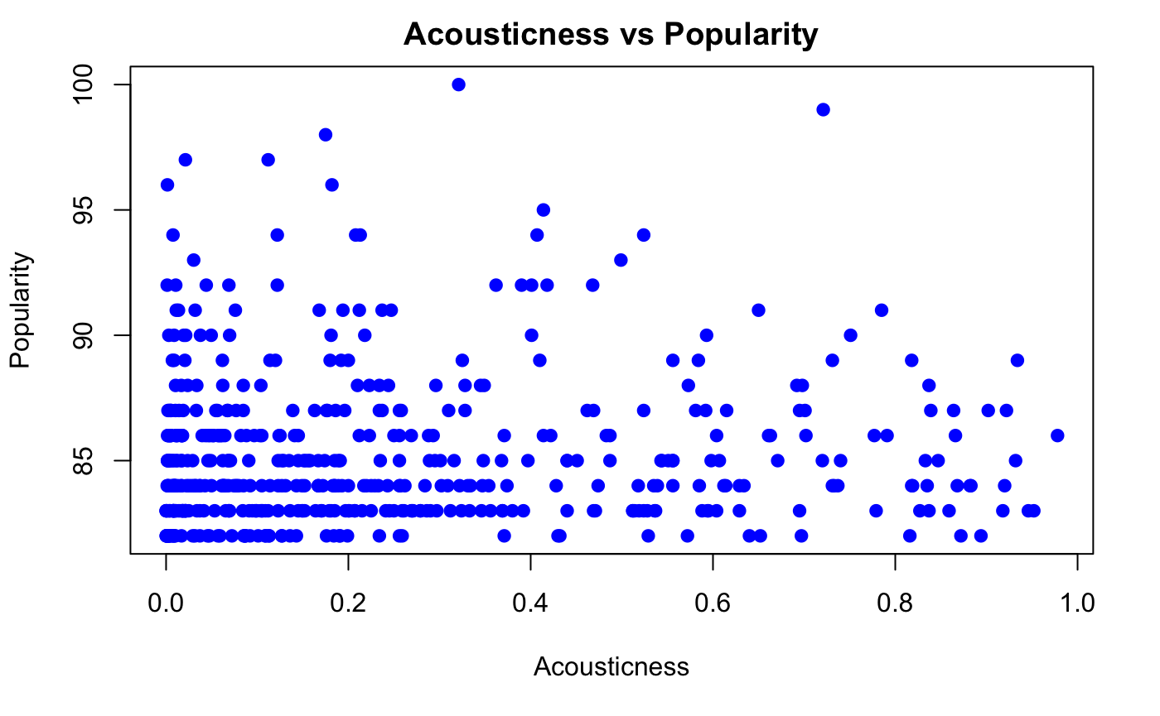
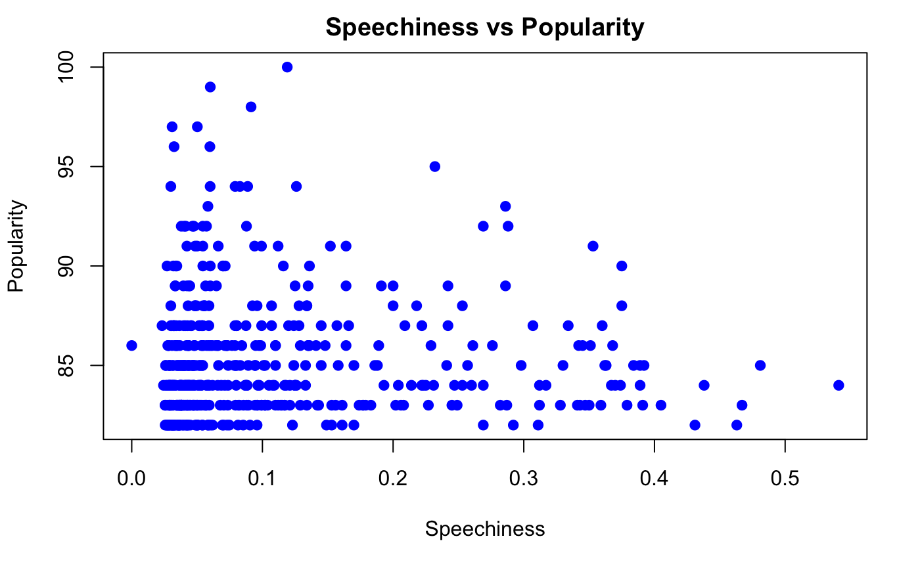
Analysis - Features Affecting Popularity of Top Songs

Slide 10
Analysis - Who are the popular artists
Data Cleaning
Check for missing values in the dataset more specifically for the names and popularity feature
Filtering the dataset to only analyze the relevant features - Name and Popularity
Check the Skewness of the data (Popularity)

Slide 11
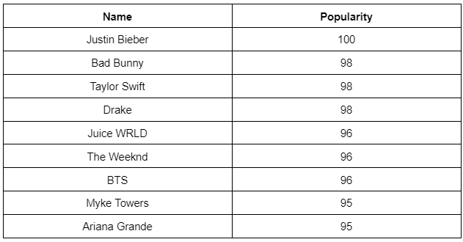
Analysis - Who are the popular artists
The table shows the artists that has popularity greater than 90 (top 10):
There were a total of 1,104,349 artists
Only 51 artists had popularity more than 90
Most artists had a popularity rating between 0 to 15

Slide 12
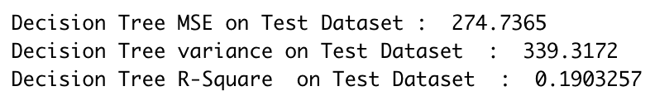
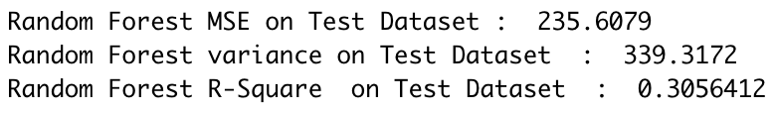
Data Modeling - Predicting Popularity Score for an Artist
Initially tried Linear regression model but the r-Squared value was 0.21.
Later tried Decision Tree Model and the results were as follows:
Finally tried the Random Forest Model

Slide 13
Data Modeling - Predicting Popularity Score for an Artist
To conclude from our research and trials for this research question, the random forest model did a better job among the three models but it appears to be that audio features alone are not good predictors of the popularity value (0 to 100). It is viable to classify if a song/artist will be popular or not, but to predict the popularity level of the song is a difficult task and it depends on a lot of other features apart from audio features.

Slide 14
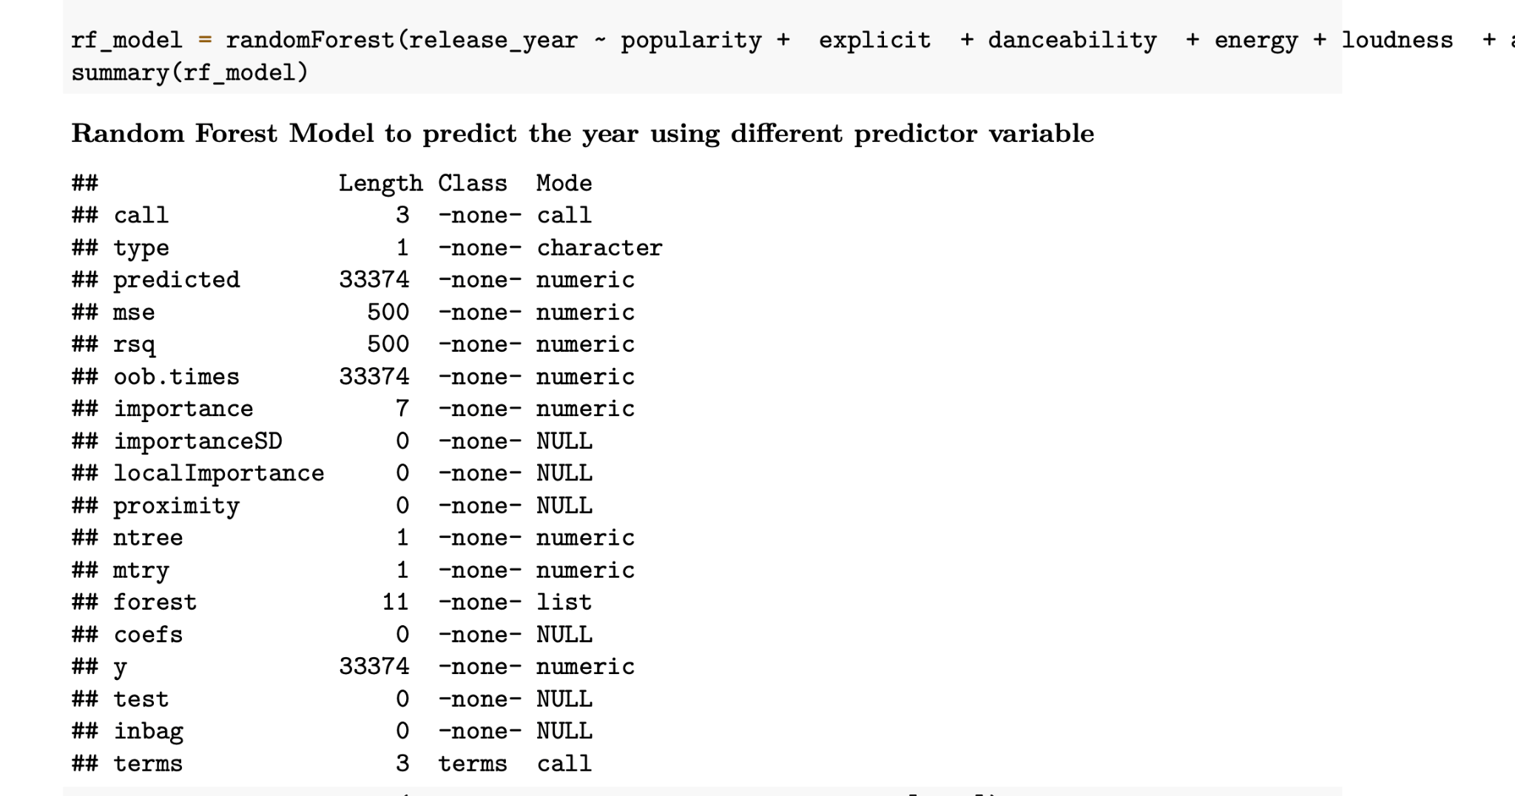
Data Modeling - Predicting Year
As the linear regression model gave the R-square value of 0.71, on training dataset which is not as good. It seems that our features are not associated linearly with the response variable, then i trained Random forest model that gave us MSE of 4.01 on test dataset, which seems considerable value.

Slide 15
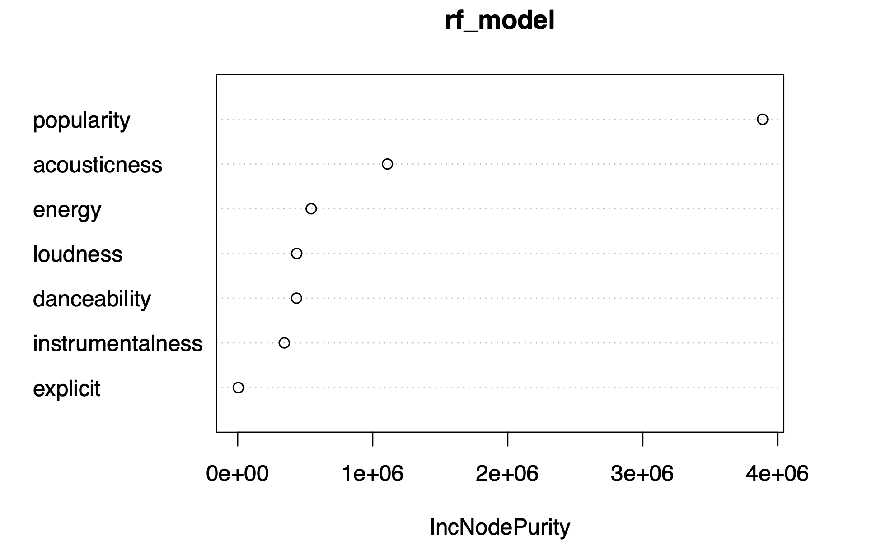
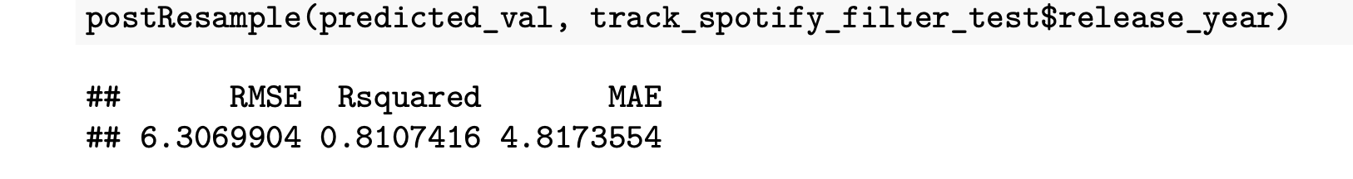
Data Modeling - Predicting Year
R-square value of 0.81 on test dataset and MSE of 4.8 which is also very less, and it shows our model is good enough to predict the year.
Along with that we found out important features that our model sees to predict the year, those are like popularity, acousticness, energy.

Slide 16
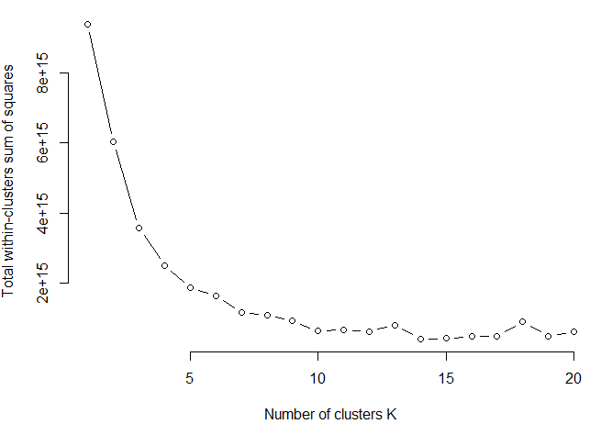
Data Modeling - Clustering
Used elbow method plus some additional thinking to determine optimal K

Slide 17
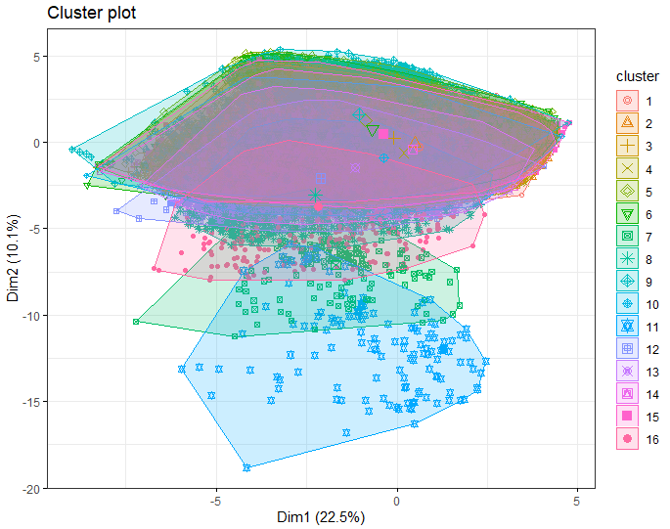
Data Modeling - Clustering

Slide 18
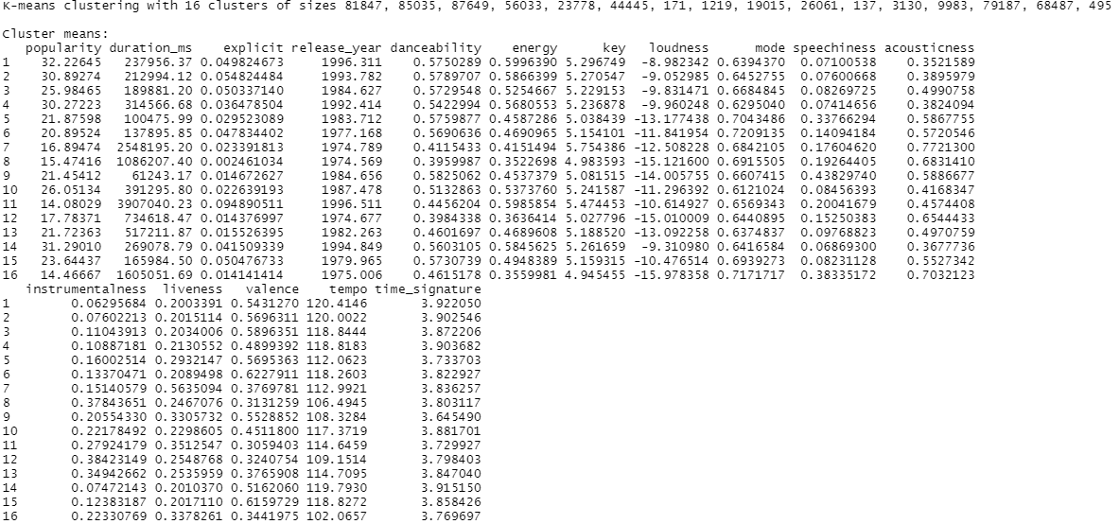
Data Modeling - Clustering

Slide 19
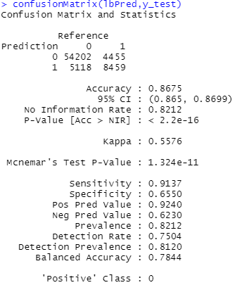
Data Modeling - Predicting Popularity
Classification problem predicting whether the music is going to be popular or not
Change original “popularity” column to a 2 level factor
Over 41 -> popular
Less than or equal to 41 -> not popular
41 cutoff is the top 25% mark
Final best performing model
LogitBoost

Slide 20
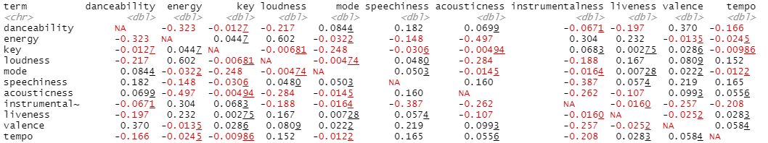
Data Modeling - Predicting Danceability
Predict Danceability based on different features:
Energy, Key, Loudness, Mode, Acousticness, Speechiness, Instrumentalness, Liveness , Valence, Tempo
Correlation Matrix:

Slide 21
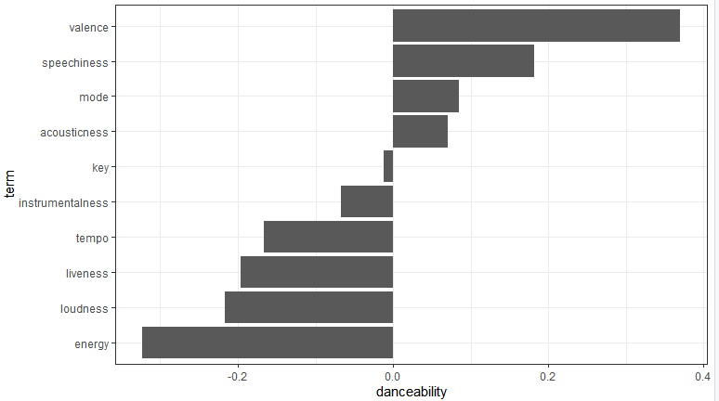
Data Modeling - Predicting Danceability
Correlation with focus on Danceability:

Slide 22
Data Modeling - Predicting Danceability
R-square values with different models:
Sr. No. | Model Type | R-squared value
1. | Multiple Linear Regression | 0.3045
2. | Multiple Linear Regression (with scaling) | 0.3045
3. | Logistic Regression | 0.072
4. | Random Forest | 0.593

Slide 23
Conclusion
For predicting the danceability, we used the random forest classifier as it gave the best R-squared value (0.593). This analysis was based on the following features: tempo, energy, valence, speechiness, loudness, liveness and mode. Having more features to predict the danceability of the song would definitely help increase the accuracy of the model.
Predicting the decade in which the song was released from different features like popularity, danceability, etc in our dataset is suggested using Random Forest classifier, and it does give a good accuracy, but having more features which give artist information also can be significant features, which can helps us to improve the accuracy. And if we can tune, and take more relevant information could also helps us to predict the year.
16 different clusters each with its unique traits and size
LogitBoost model shows best performance in predicting the popularity of the dataset
Pop genre was most famous in 60s, and r&b got into picture after 80s
Analyzed Top 500 songs. Some feature do have an impact on popularity, some don't. Detail in report.
To check which artists were famous, we used the popularity feature and categorized artists as popular if their popularity was more than 90. This analysis showed that out of 1,104,349 artists, only 51 artists had a popularity rating of more than 90.
To conclude from our research and trials for this research question, the random forest model did a better job among the three models but it appears to be that audio features alone are not good predictors of the popularity value (0 to 100). It is viable to classify if a song/artist will be popular or not, but to predict the popularity level of the song is a difficult task and it depends on a lot of other features apart from audio features.

Slide 24

THANK YOU
For any questions, please feel free to reach out to us on our emails:
ayousaf@hawk.iit.edu
cchen153@hawk.iit.edu
sjaradi@hawk.iit.edu
sjawad@hawk.iit.edu

